Slide 1
PerFectIT
Midway Design Review
December 11, 2017

Slide 2
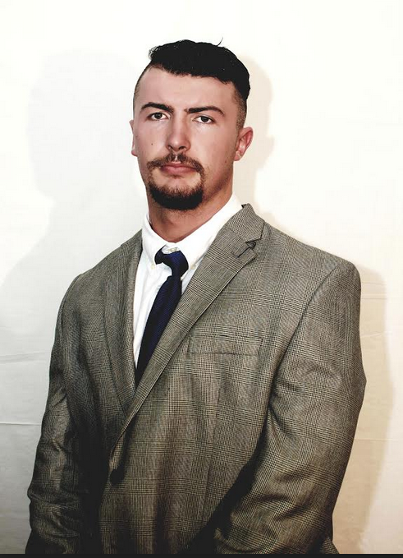
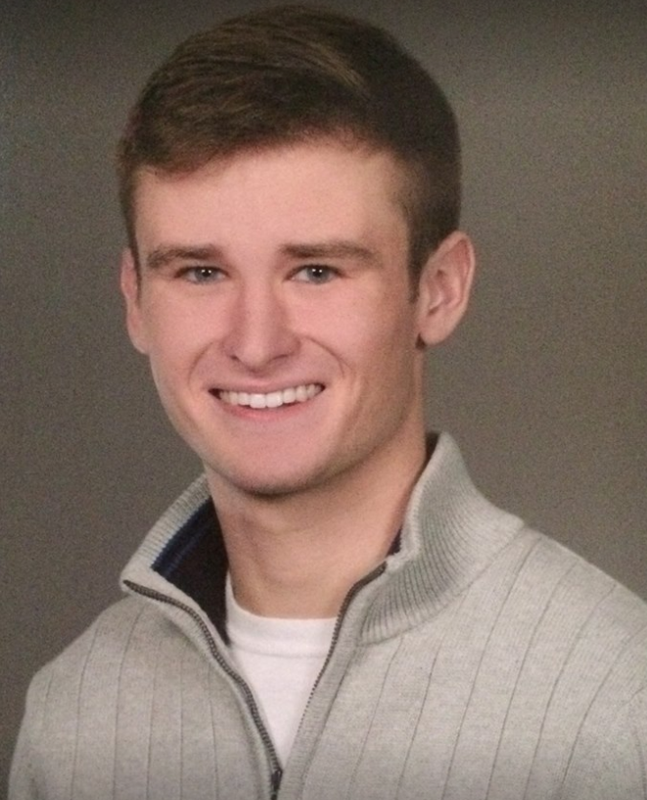
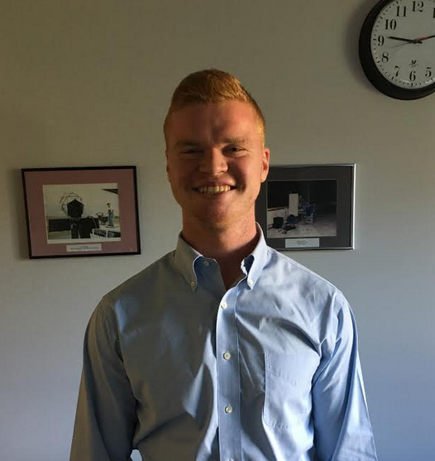
Introducing team members
Sai Yarram
Nick Raymond
Andrew Sjogren
Maxwell Gerhardson

Slide 3
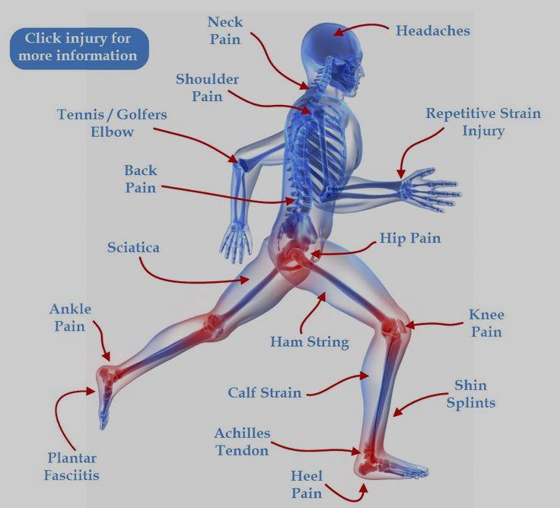
Injury prevention while exercising
Causes of Sports Injuries
Repetitive actions with poor form
Overtraining
Misuse of Exercise machines
Overlooking warm-up exercises
Current Prevention Methods
Personal trainers
Online tutorials
Expensive Group Classes

Slide 4
Our Solution: PerFectIT
A wearable monitoring system integrated with:
Pressure mapping insoles
Utilize pressure sensors to monitor a user’s balance during resistance exercise
Electromyogram (EMG) measuring knee braces
EMG sensors measure muscle strain at the quadriceps to ensure the user is driving through exercise with uniform force
Inertial Measuring Unit (IMU)
3-axis gyrometer and accelerometer measure imbalances in your center of gravity through your hips
Integrated into clip-on device (clip to weight-lifting belt or shorts)

Slide 5
Requirements Analysis: Specifications
Real-time monitoring and analysis of a person’s form while squatting
Use EMG to monitor the force attributed by each leg during the exercise
Measure the weight distribution and changes in the user’s center of gravity in real-time during resistance exercise
Foot pressure mapping
Inertial measuring unit (IMU)
Wearable technology
All hardware is built into a wearable device (knee brace, shoe insole, belt clip)
Wirelessly communicate data to mobile application for analyses
Low power consumption

Slide 6
Individual Responsibilities
Software Team
Sai Yarram
Server and Backend development and Implementation
User Authentication, Data Storage/Retrieval Implementation
UI and Algorithm Development
Nick Raymond
Hardware and Software Integration
Implementation of Bluetooth
Weight calibration analysis with FSR
UI and Algorithm Development
Hardware Team
Andrew Sjogren
Decision between FSR and Piezo Sensors
Implementation of chosen sensor into constructed foot insoles
Testing and calibration of foot insoles
PCB schematic design for foot insoles
Data collection
Maxwell Gerhardson
Design and implement AD8232 for EMG sensing into knee brace
PCB design for EMG sensing circuit
Implement 9DOF razor IMU

Slide 7
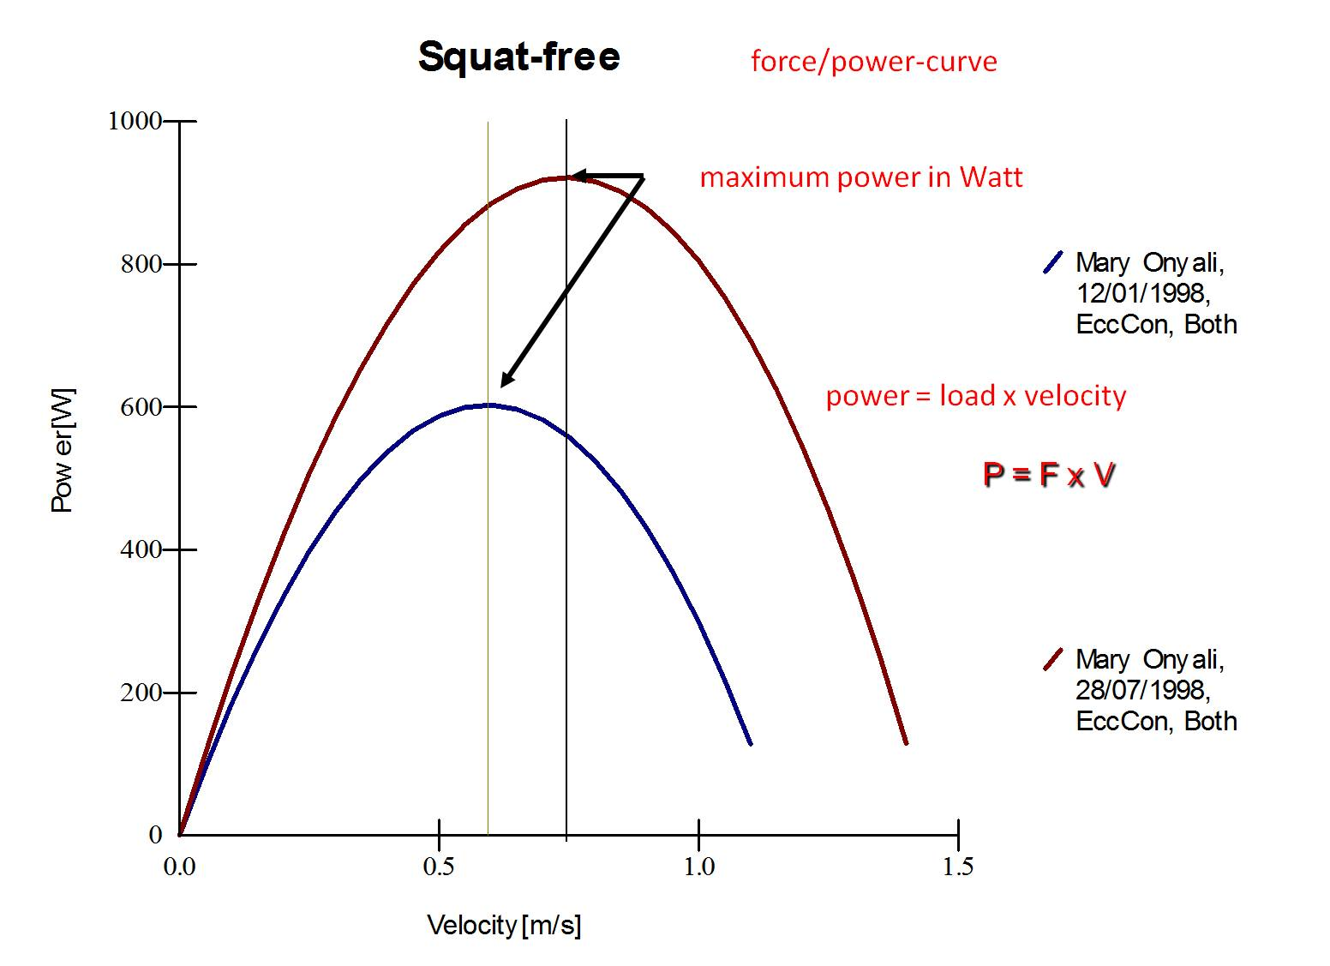
Proposed MDR Deliverables
Working foot sensors
Show expected readings on oscilloscope
Breadboard to be printed to the PCB
Decision between silver electrodes and textile cloth
Skeleton of Mobile User Interface
Initial Page
Login/Signup
Main Page

Slide 8
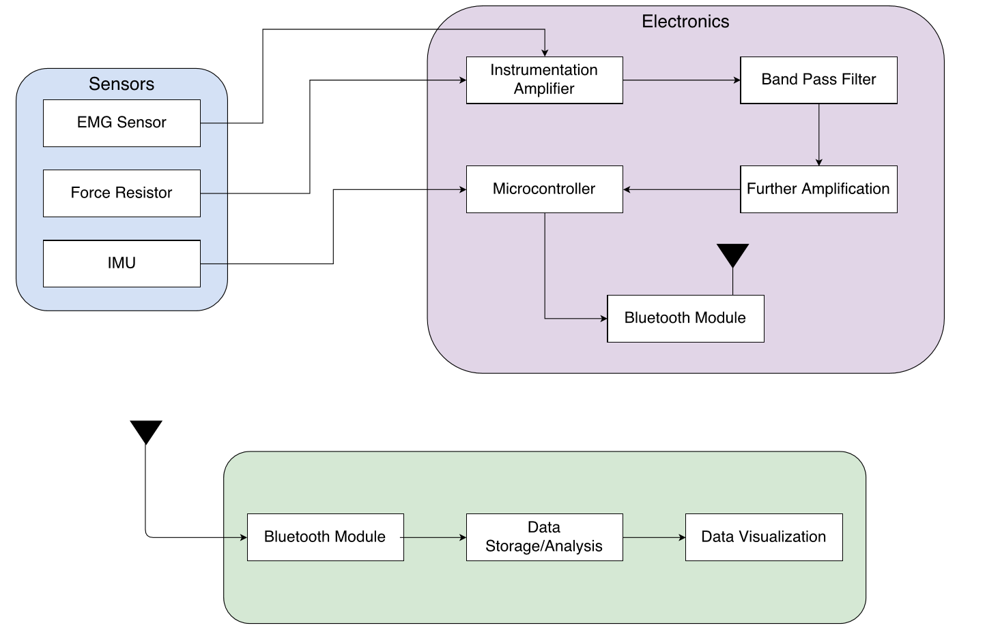
Previous Block Diagram

Slide 9
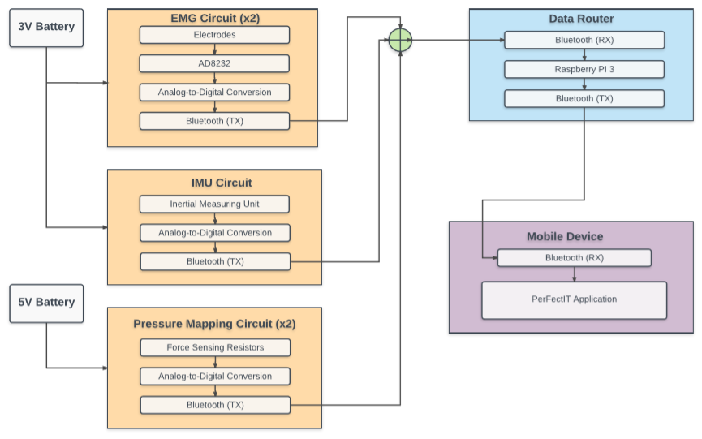
Revised Block Diagram

Slide 10
Sensors
EMG Sensors
Conductive fabric electrodes
Signal detection
Sewn into knee brace
Analog Devices AD8232
Amplifier (~ 40dB of gain)
Filter (single-pole HPF @ 5Hz)

Slide 11
Sensors
Inertial Measuring Unit
SparkFun 9DoF Razor IMU MO
3-axis accelerometer
3-axis gyroscope
3-axis magnetometer
Integrated into clip on device
Clipped to weight lifting belt
Monitors the orientation of the user at the hips
This location acts as the users center of gravity

Slide 12
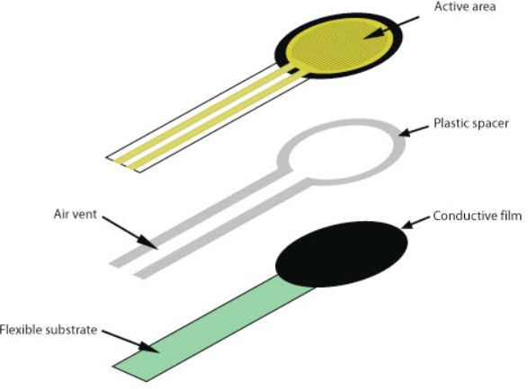
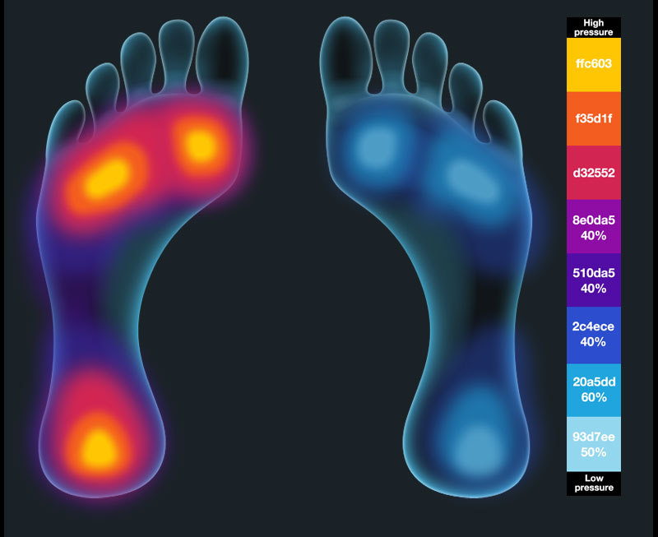
Foot Sensors
Force Sensing Resistors (FSR)
Detect pressure, squeezing, and weight
Changes resistive value depending on pressure
More expensive than piezo sensors, but more reliable
Still low cost

Slide 13
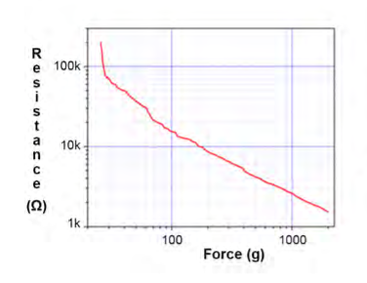
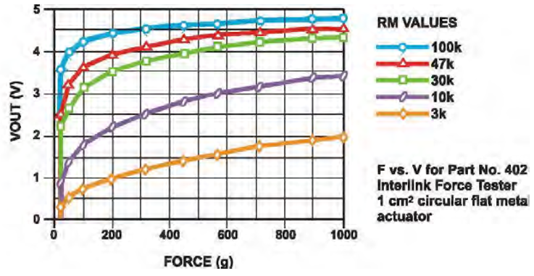
Foot Sensors

Slide 14
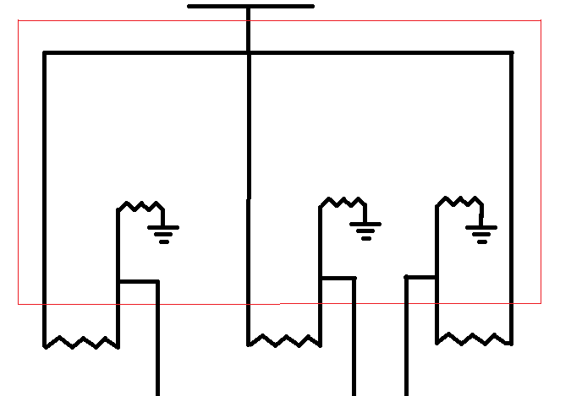
Foot Sensor Schematic (PCB Design)
5 V
710
710
710
FSR
FSR
FSR
V1
V2
V3

Slide 15
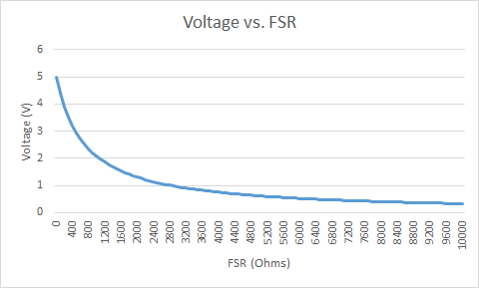
Foot Sensors

Slide 16
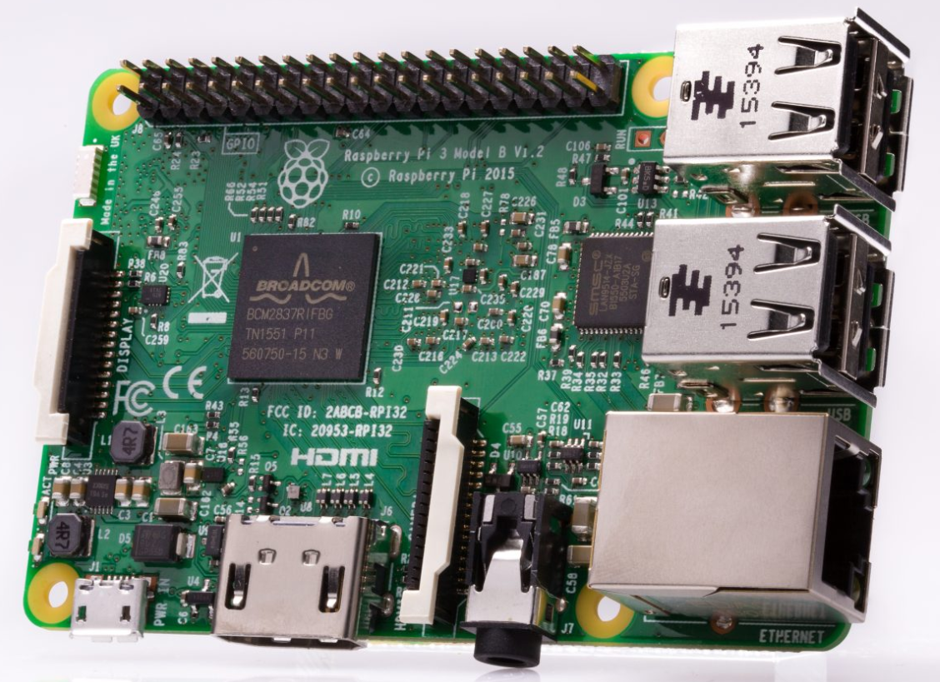
Raspberry Pi 3 Model B
Single board computer with Wireless LAN and Bluetooth Connectivity (BLE)
40 pin GPIO
Micro SD Port
$35

Slide 17
Power Budget

Slide 18
Software Design Specifications
Database Storage Options
SQLite
AWS
Firebase
SQLite
Light weight, no network access, relational
AWS
Cloud Service, User Authentication, Cloud Storage
Firebase
Cloud Service, User Authentication, NoSQL, Cloud Storage, Compatible

Slide 19
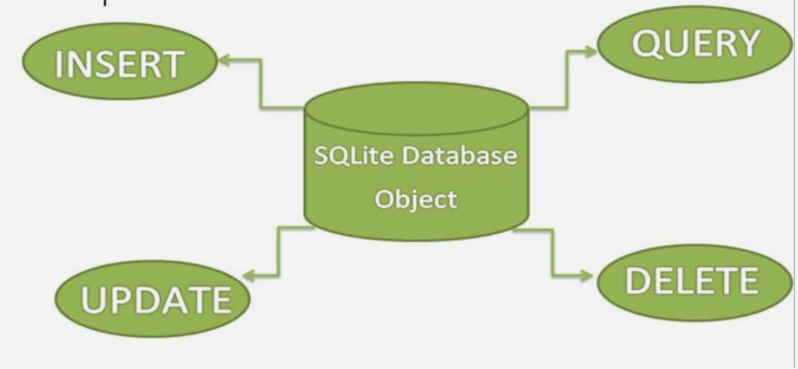
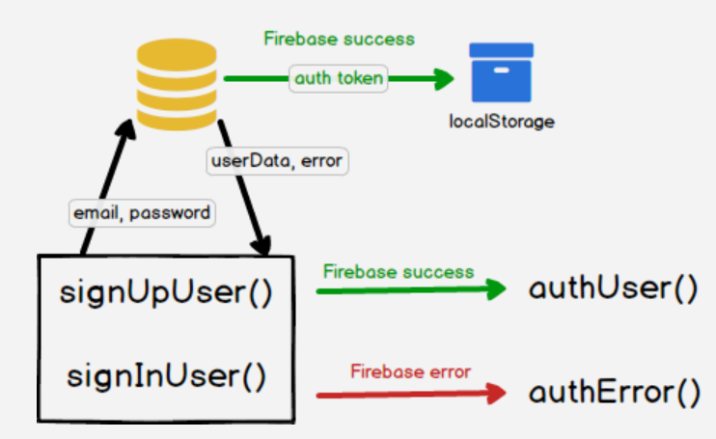
Data Store and Retrieve Protocol
MDR
Chose SQLite Implementation
Get the skeleton and the idea of the future fixed
Familiarize with graphics and intents
Looking into the future
Scale the project
Implement cloud service

Slide 20
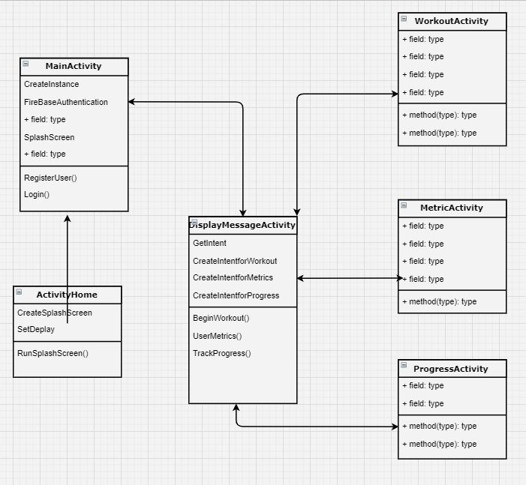
Block Diagram
Splash Screen
Main Activity
Display Message Activity
Branch:
Workout Activity
Metric Activity
Progress Activity

Slide 21
Weight Algorithm
Relative Weight
Leveling off at the top
Noise issues
Application Data Aggregates

Slide 22
Weight Calibration
-Good Relativity
-Inside of foot takes on more of weight with added load
-Clear weight shift from standing to squatting

Slide 23
IRB
-January 25 Submission Deadline for February 8 meeting
-Begin to squat with just the bar looking in the mirror to adjust form
-2 sets x 10 reps
- Add weight to bar according to your strength level
-25% of 1 rep maximum 2 sets x 6 reps
-50% of 1 rep maximum 2 sets x 6 reps
-75% of 1 rep maximum 1 set x 5 reps

Slide 24
Proposed CDR Deliverables
Sai Yarram
Have a fully functioning backend of the application
Integrate with the cloud and have a database setup
Authenticate Users, Stability, Analytics
Work with Nick Raymond on UI and Data Processing/Algorithms
Nick Raymond
Work on UI, Bluetooth Connection, and Data Processing
Connect the hardware to the app
Develop an algorithm with Sai Yaram

Slide 25
Proposed CDR Deliverables
Andrew Sjogren
Complete PCB for foot mapping sensors
Communicate foot sensor data via bluetooth to Raspberry Pi
Work with Max to communicate data to Android
Testing / debugging of integrated subsystem
Max Gerhardson
IMU
Complete PCB for emg sensors
Communicate EMG data via bluetooth to Raspberry Pi
Work with Andrew to communicate data to Android
Testing / debugging of integrated subsystem

Slide 26
Schedule
 | 1/10 | 1/30 | 2/10 | 3/1 | 4/28
Design PCB for EMG and FSR circuits
Configure IMU
Communicate sensor data to Raspberry Pi
Communicate data from Pi to mobile app
Test and debug system
Fully Functioning Back End
Finalize Algorithm
Integrate Cloud + Database Setup
Bluetooth Connection
= Max & Andrew
= Nick & Sai

Slide 27
Thank you
Questions?

